Slide 1


Detecting Tax Evasion Using Financial Transaction Data
CSA1612-Data Warehousing and Data Mining For Data Science
Presented By:
G. Lakshman(192324069)
D.V Sai Kumar(192372321)
C. Nanda Kishore(192324048)
Guided by:
Dr. A.Gayathri
Dr. Fahad Iqbal

Slide 2
Abstract
Tax evasion poses a major challenge to national revenue systems, requiring efficient and intelligent detection mechanisms.
This project leverages financial transaction data to identify potentially suspicious entities and anomalous transaction patterns.
A machine learning–based model (LightGBM) is developed to classify entities as normal or suspicious based on transaction behavior.
Feature engineering and graph analysis are used to extract hidden relationships and enhance detection accuracy.
Results highlight the potential of data-driven tax audit systems to improve compliance and reduce financial fraud.

Slide 3
Module 1 – Data Understanding & Preprocessing

Slide 4

Introduction
Tax evasion significantly reduces government revenue, affecting public services and infrastructure.
Traditional audits are manual, costly, and time-consuming, often missing complex fraud schemes.
Using Machine Learning and Graph Analytics, we can automatically detect suspicious entities and improve audit efficiency.
Goal: Identify potential tax evaders accurately and explainable to assist tax authorities.

Slide 5
Objectives
To detect potential tax evasion using financial transaction data through data-driven analysis.
To develop a machine learning model (LightGBM) that classifies entities as normal or suspicious.
To extract key behavioral features such as transaction frequency, amount, and revenue ratio.
To analyze hidden relationships using graph/network analysis to identify suspicious transaction patterns.
To evaluate model performance using metrics like Precision, Recall, and AUC.
To provide interpretable results using SHAP explainability for better audit decision-making.
To enhance audit efficiency and support tax authorities with actionable risk insights.

Slide 6
Literature Review / Background
Author / Year | Title / Source | Key Contribution | Relevance to Current Project | Limitations / Gaps
J. Patel & M. Singh, 2024 | Financial Fraud Detection Using Transaction Data | Proposed a data preprocessing and anomaly detection pipeline using Isolation Forest | Helps design unsupervised anomaly detection module for tax evasion patterns. | Evaluated only on generic fraud data, not tax-specific datasets.
World Bank Report, 2023 | Use of Data Analytics in Tax Administration | Discussed integration of AI tools in national tax systems | Provides high-level framework for government-level tax data integration. | Descriptive in nature, lacks detailed technical implementation.
A. Sharma & R. Gupta, 2023 | Graph-Based Detection of Financial Evasion Networks | Used graph neural networks (GNNs) to detect collusion and hidden transaction links. | Supports development of network-analysis-based module for suspicious relation. | Requires extensive labeled graph data; computationally expensive.

Slide 7
Problem Statement
Traditional tax audits are manual, time-consuming, and resource-intensive, making it difficult to check all transactions.
Complex schemes like circular transactions, high-value transfers, and underreporting of revenue often go unnoticed.
Existing detection methods may generate false positives or miss subtle fraudulent patterns, reducing audit efficiency.
There is a need for an automated, scalable, and explainable system to detect potential tax evasion using transaction data.
Detecting suspicious entities early can save government revenue and improve compliance.

Slide 8
Module 2 –Detection Model & Evaluation

Slide 9
Methodology
Data Collection & Preprocessing: Gather transaction data, clean missing/inconsistent values.
Feature Engineering: Aggregate entity-level features (total, avg, max/min, transaction count), compute ratios (sent-to-revenue), optional graph features.
Graph Network Analysis (Optional): Build transaction graph, detect circular transactions.
Model Training: Train LightGBM classifier; handle class imbalance.
Evaluation & Explainability: Metrics: Precision, Recall, AUC; explain using SHAP values.
Alert Generation: Rank entities by risk score; generate actionable alerts.

Slide 10
System Design / Architecture
Data Source
Feedback
Ingestion
Dashboard
Processing
Evaluation
Feature Engineering
ML Model

Slide 11
Dual-Model Strategy
We implemented a two-pronged approach for comprehensive threat coverage:
Random Forest (The Guard Dog):
A supervised learning model.
It is trained on historical data to learn and recognize known patterns of fraudulent behavior with very high accuracy. It's our first line of defense.
Isolation Forest (The Scout):
An unsupervised anomaly detection model.
It does not learn from past fraud labels. Instead, it mathematically identifies rare and unusual data points that deviate from the norm. This is crucial for catching new, unknown fraud tactics.

Slide 12
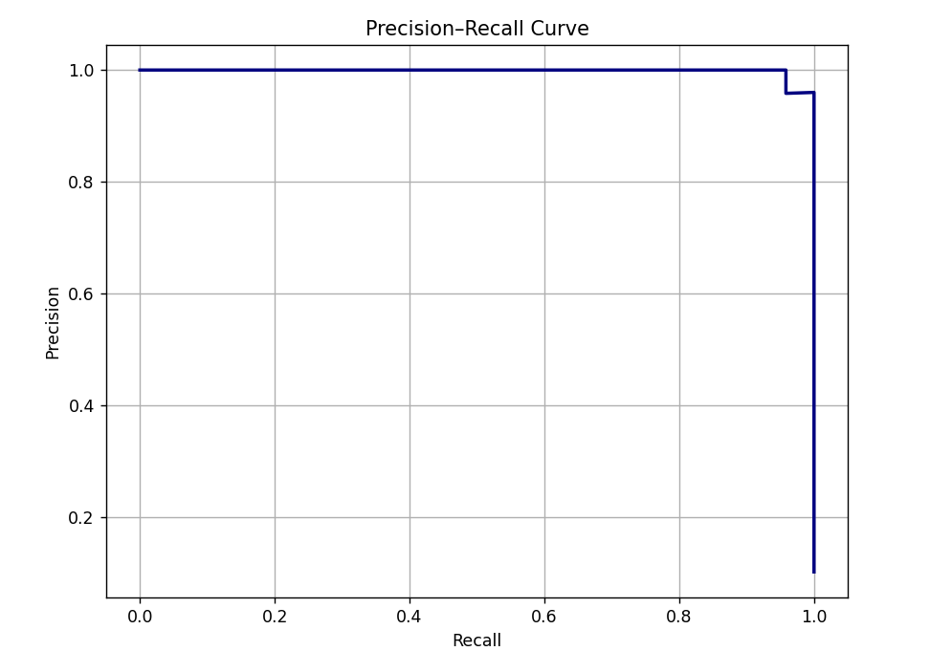
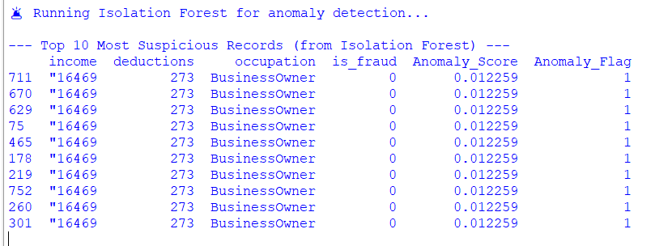
Sample Output
Precision & Recall:
High Precision: When the model flags a transaction as fraud, it is very likely to be correct, minimizing false alarms.
High Recall: The model successfully finds the vast majority of all true fraudulent cases in the data.

Slide 13
Future Scope
Integration with Real Data: Combine bank statements, invoices, and tax declarations for enhanced accuracy.
Real-Time Detection: Develop streaming analytics to detect suspicious transactions as they occur.
Advanced Features: Use graph embeddings, anomaly detection algorithms, or deep learning for complex patterns.
Cross-Border Analysis: Identify tax evasion in international transactions.
Continuous Learning: Regularly retrain models to adapt to evolving fraud patterns.
Deployment: Build dashboards for tax authorities with actionable alerts and visual insights.

Slide 14
Conclusion
Automated detection of tax evasion improves audit efficiency and reduces manual effort.
Machine learning models (LightGBM) can identify hidden and subtle fraud patterns.
Feature engineering and graph/network analysis enhance detection accuracy.
SHAP values provide explainable insights for auditors to understand model decisions.
Risk-scored alerts help prioritize high-risk entities for further investigation.
The framework is scalable, data-driven, and adaptable to larger or real-world datasets.

Slide 15
References
Bolton, R. J., & Hand, D. J. (2018). Statistical fraud detection: A review. Statistical Science, 17(3), 235–255.
Ngai, E. W., Hu, Y., Wong, Y. H., Chen, Y., & Sun, X. (2019). The application of data mining techniques in financial fraud detection: A classification framework and an academic review of literature. Decision Support Systems, 50(3), 559–569.
Chen, T., & Guestrin, C. (2016). XGBoost: A scalable tree boosting system. Proceedings of the 22nd ACM SIGKDD International Conference on Knowledge Discovery and Data Mining.
Lundberg, S. M., & Lee, S. I. (2017). A unified approach to interpreting model predictions. Advances in Neural Information Processing Systems, 30.

Slide 16
THANK YOU

